Slide 1
Skin Disease Diagnosis on Darker Skin
By: Reagan Esteves, Jamie Hartman, Charles Tyndal, and Chenyu Zhao
Faculty Mentors: Dr. Zhengming Ding and Dr. Jihun Hamm

Slide 2


Slide 3
Formulation of our Problem
01
Our Proposed Approach
02
04
TABLE OF CONTENTS
Feasibility, Novelty, and Sophistication
Previous Work
03
05
Work we have conducted so far
06
Timeline of our Project

Slide 4
01 and 02
The Problem and our Approach

Slide 5
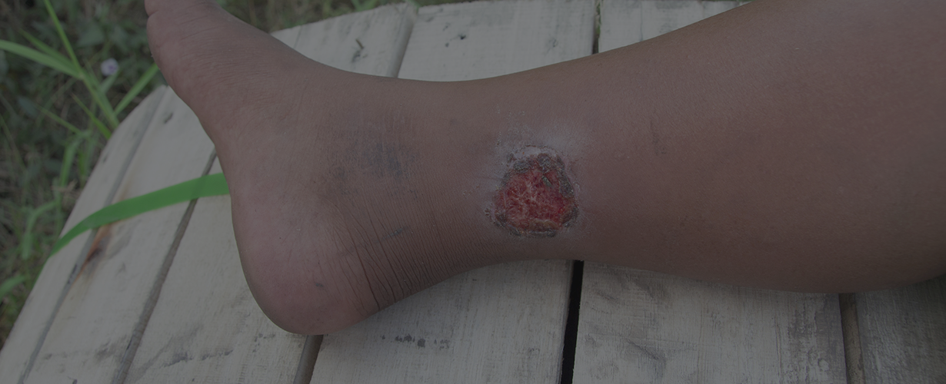
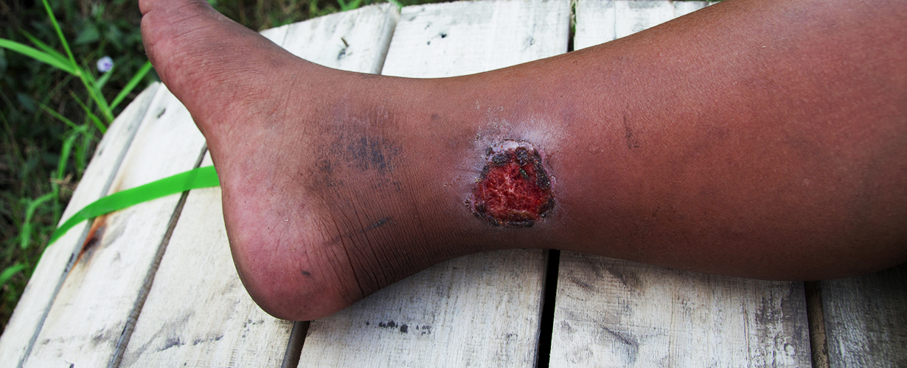
The Problem
Diagnosing skin disease is expensive (sub saharan Africa)
Currently, only dermatologists diagnose skin diseases
Issue: time consuming and expensive for patients
Many patients cannot afford the time and expenses
Scenario:
Mr. A has a Buruli ulcer
Can’t meet expense and time for appointment and treatment
Solution: take a photo of the problem -> upload into our Application (Picture A)
Application crops and enhance the image (Picture B)
Gives diagnosis: Buruli Ulcer, and the confidence level 95%
Give estimate of the recovery status aka 20% recovered
Picture A
Picture B
Notes:
Diagnosing skin disease is a costly process especially in sub saharan Africa. Right now only trained dermatologists can diagnose skin diseases which can take valuable time and money from the patients, both of which they may not have.
An example of the problem, potential user Mr. A has a Buruli ulcer but does not have the time or the money or the means to get to a doctor. What Mr. A does have is a phone so he takes a photo of the problem and uploads it to our Application (Picture A). The application will first crop and enhance the image (Picture B). Next the application will give a diagnosis, Buruli Ulcer, and the confidence level 95%. Finally our application will give an estimate of the recovery status aka 20% recovered

Slide 6
Proposed Approach
Overall application: allow potential user to take a photo of their skin disease and identify potential disease
1st step: analyzing the image and determining the region of interest (ROI)
main goal for our group
2nd step: enhancing cropped image with techniques
super-resolution, color calibration
3rd step: disease diagnosis
Domain adaptation, Augmentation techniques
outputs the disease and the confidence level
4th step: Interpretation
Uses deep learning and visual patterns
Output: potential recovery status of the patient
Notes:
The overall application that we are contributing too will allow a potential user to take a photo of their skin disease and it will tell them which potential disease (if any) they might have.
The first step of the process is analyzing the image and determining the region of interest (ROI) aka the area in the picture that has the potential skin disease and cropping the image around that
This is the main goal for our group
The second step is enhancing the cropped image using techniques like super-resolution and color calibration
The third step is disease diagnosis which uses Domain adaptation, and Augmentation techniques
This outputs the disease and the confidence level
The fourth step is Interpretation which uses deep learning and visual patterns
This will output the potential recovery status of the patient

Slide 7
03
Previous/Similar Works

Slide 8
Similar Works
Project Name
Skin Tone
Disease target
Image Processing & Diagnosis Techniques
Our Project
“Skin Disease Identification on Darker Skin Tones”
Yaws, Leprosy, Scabies, Mycetoma, & Buruli Ulcer
Image filtering process: increase contrast, angle/lighting correction, Gaussian blur -> sharpen low-quality images
AI: skin disease identification based on a given data set of skin disease images on darker skin tones
Dark
“Skin Disease Recognition Method Based on Image Color and Texture Features”[1]
Herpes, Paederus, Dermatitis, Psoriasis
Image color techniques: reduce noise in images
GLCM tool: analyzes skin texture
Light
“Deep Learning Techniques for Skin Segmentation on Novel Abdominal Dataset”[2]
Skin Area: Abdominal Skin
Segmentation
Mask R-CNN (generates segmentation mask)
U - Net: classifies infection & identifies the area of infection
Light
No Target
Notes:
The sharpening and enhancement of the photos allow a higher accuracy in determining the skin problem with AI.

Slide 9
04
Feasibility, Sophistication, and Novelty

Slide 10
Feasibility & Sophistication
Feasibility
Sophistication
Input of project: dataset of skin diseases images on darker skin tones
Out of project: skin disease identification on darker skin tones
Sufficient amount of images for each skin disease
Understanding of computer vision techniques - such as segmentation, filtering images, and deep learning
Data is from hospitals located in Africa
No access yet - until the hospitals send us the CITI training.
While waiting - use public data images from google to run tests on techniques
Ex. filtering the poor quality images for a more accurate diagnosis
Using existing computational method such as filtering, ROI detection, segmentation, superpixels, and deep learning
different combination of techniques and focus on darker skin tones
Main issue: lack of data and images on darker skin tones with the correct diagnosis
Currently taking courses needed to address and implement the project
Improve efficiency of skin disease identification
Notes:
A year’s worth of work justify the ideal result of being able to implement
Improve efficiency of skin disease identification based on the data set of pictures given. So we need a sufficient amount of data for each disease identification

Slide 11
Novelty
Other works vs Ours:
don’t target skin disease strictly on darker skin tones
they focused on specific body parts
our project does not have a specific skin area
Target of disease:
focus on Yaws, Leprosy ,Scabies, Mycetoma, and Buruli Ulcer
prevalent in Sub Saharan Africa
Application of Computational Techniques
Different technique combination
filter process -> challenging
Hard to detect skin disease in early stages on darker skin tones
filtering process is different compared to lighter skin tones
Ex. the combination and number of filters

Slide 12
05
Work Conducted so far

Slide 13
Work Done So Far
Lots and Lots of Research
Primary Focus
Studying similar works in an attempt to find the following:
How other people have used machine learning AI to identify skin diseases
The challenges that come with analyzing low quality photos and how they were able to make them more accurate
How works identifying skin disease differ between different skin tones and what we must do to best identify in dark skin tones
Secondary Focus
Finding data and other works to build from
We have been able to gather code from other ROI detection systems working on similar
We are currently waiting on our primary data set, but in the meantime we have been looking for similar data to begin training with.

Slide 14
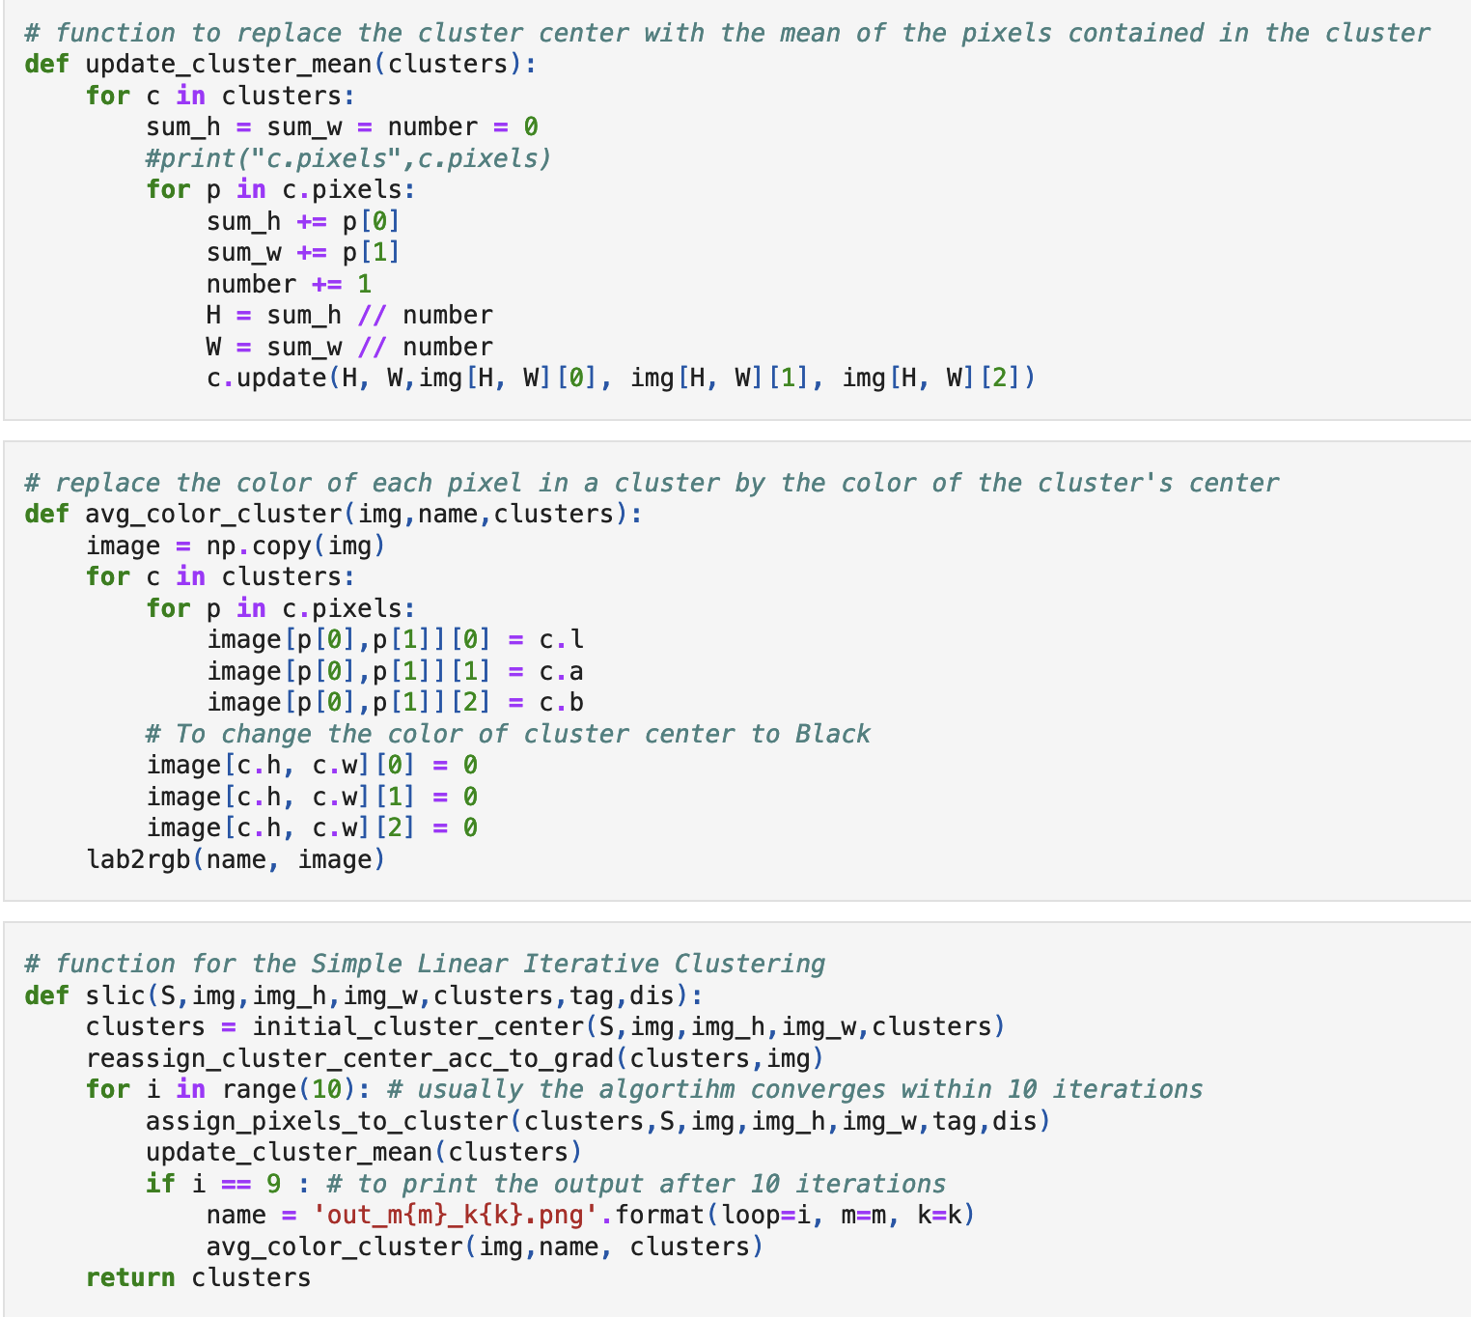
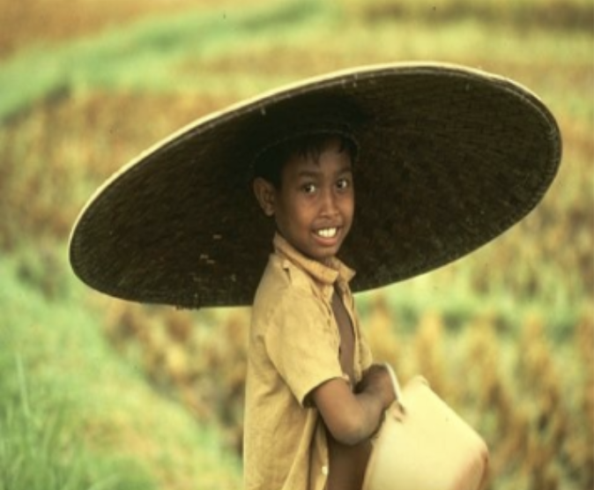
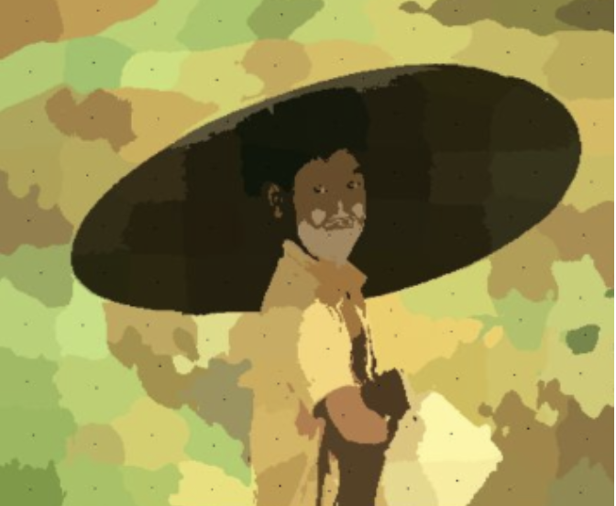
Portion of Superpixel pseudo code [3]
goal: cluster the similar pixel colors for easier segmentation
Example of In/Output
Identifying the cluster region using mean
2. Making the cluster the same color by selecting the cluster’s center color
3. Simple linear iterative clustering

Slide 15
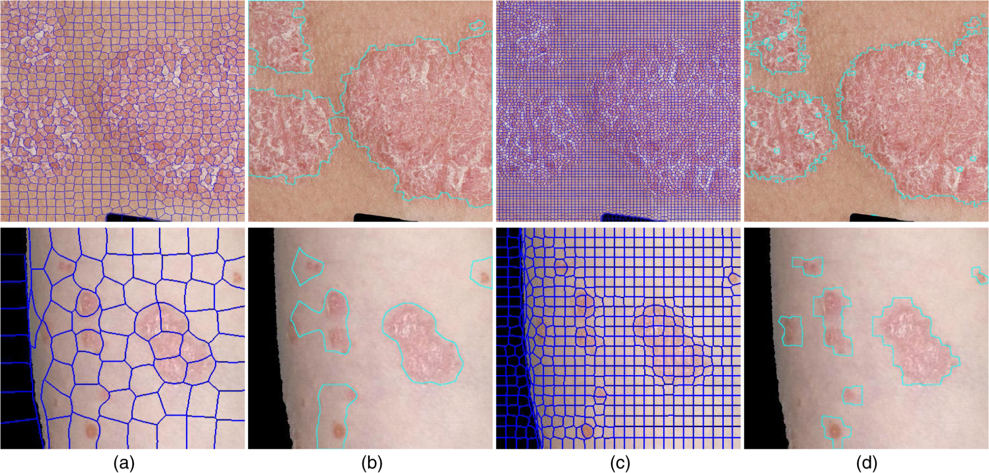
Example of clustering the similar pixel colors on skin disease for easier segmentation [4]

Slide 16
06
Timeline

Slide 17
Timeline of our Project
Oct/Early Nov
CITI Training for Private Data Samples
March 2023
Possible final implementation of thermal image detection of skin diseases on skin of color
Nov
Segmentation to acquire region of interest, SLIC, Superpixels
contrast/lighting/angles
Jan 2023
AI identification
Oct
Gather Public Data Samples:
Background information
Skin of color pictures in bad lighting, quality, and noisy background
Skin diseases on skin of color
Nov/Dec
Begin Enhancement/ Filtering/Color Space of Images (fixing contrast, lighting, and angles
April 2023
Capstone Expo
Feb 2023
Implementation of Deep Learning

Slide 18
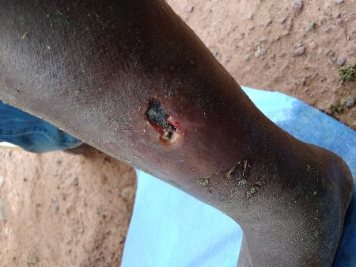
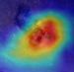
ROI Detection
[Weakly supervised Segmentation]
Aim 1: Automatic Preprocessing
Input: Raw Images
Enhancement
[Super-resolution, Color calibration]
Output 1
middle calf
[Deep learning,
Visual patterns]
[Domain adaptation, Augmentation]
Output 3
Aim 3:
Interpretation
Aim 2:
Disease Diagnosis
Output 2
Disease: buruli ulcer
Confidence: 90%
Visual Cues
Recovery Status

Slide 19
References
[1] Li-sheng Wei, Quan Gan, Tao Ji, 2018. "Skin Disease Recognition Method Based on Image Color and Texture Features", Computational and Mathematical Methods in Medicine, Retrieved from https://doi.org/10.1155/2018/8145713.
[2] Topiwala Anirudh, Al-Zogbi Lidia, and Fleiter Thorsten, Krieger Axel 2019. “Adaptation and Evaluation of Deep Learning Techniques for Skin Segmentation on Novel Abdominal Dataset”, In 2019 IEEE 19th International Conference on Bioinformatics and Bioengineering (BIBE),p. 752--759, IEEE.
[3] Darshita, Jain. 2020. Superpixels and Slic. (April 2020). Retrieved October 2, 2022 from
https://darshita1405.medium.com/superpixels-and-slic-6b2d8a6e4f08
[4] Yasmeen M. George, Mohammad Aldeen, Rahil Garnavi, "Automatic psoriasis lesion segmentation in two-dimensional skin images using multiscale superpixel clustering," J. Med. Imag. 4(4) 044004 (10 November 2017) https://doi.org/10.1117/1.JMI.4.4.044004
Notes:
ACM style

